Slide 1
An Image is Worth 16x16 Words: Transformers for Image Recognition at Scale
Original Paper Authors: Alexey Dosovitskiy , Lucas Beyer, Alexander Kolesnikov Dirk Weissenborn , Xiaohua Zhai, Thomas Unterthiner, Mostafa Dehghani, Matthias Minderer, Georg Heigold, Sylvain Gelly, Jakob Uszkoreit, Neil Houlsby
Conference: ICLR 2021

Slide 2
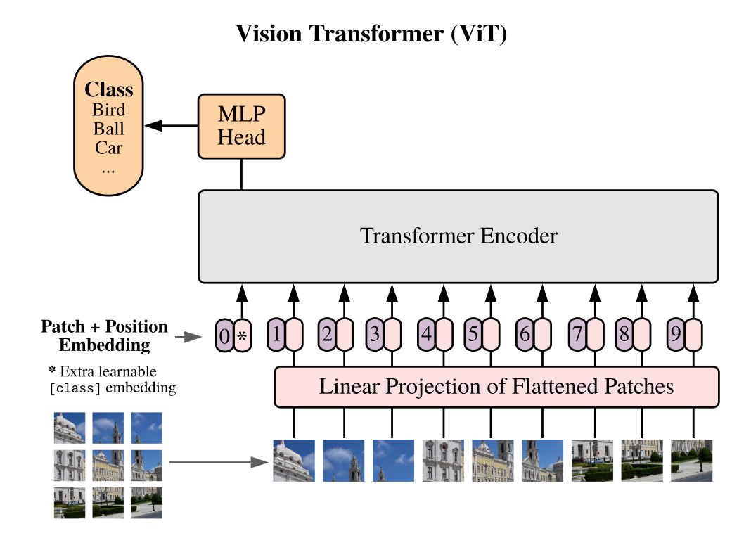
Architecture
Follows the original Transformer architecture as closely as possible.
Each image is split into fixed-size patches, then the image patches are flattened.
Lower-dimensional linear embeddings from these flattened image patches are created
1D Position embeddings are added to the patch embeddings to retain positional information
The resulting sequence of embedding vectors is fed to a to a state-of-the-art transformer encoder
Encoder includes: Multi-Head Self Attention Layer, Multi-Layer Perceptrons Layer, Layer Norm
An extra learnable embedding , classification token, is added to the sequence whose state at the output of the Transformer serves as the image representation class.

Slide 3
Dataset: CIFAR-100
ViT was pre-trained on the ImageNet and ImageNet-21k datasets with image labels
We fine-tuned ViT on CIFAR-100 dataset
The CIFAR-100 dataset consists of 60000 32x32 colour images in 100 classes
There are 50000 training images and 10000 test images
The 100 classes are grouped into 20 superclasses
There are two labels per image - fine label (actual class) and coarse label (superclass).
Each class contains 600 images, 500 for training and 100 for testing

Slide 4
Dataset: Food-101
We also fine-tuned ViT on Food-101 dataset
This dataset consists of 101 food categories, with 101'000 images.
There are 75750 training images and 25250 test images
For each class, 250 manually reviewed test images are provided as well as 750 training images.

Slide 5
Implementation
Library: PyTorch
We use ViT (base-sized model)
Image Transformations: a ViT feature extractor is initialized with a previously saved configuration to apply appropriate transformations to images before being passed to ViT
The output tensors contain pixel values, which are the numeric representations of the image that we pass to the model.
Transformation of dataset is applied for optimization and acceleration of performance
Data collator to form batches
Accuracy as evaluation metric from HuggingFace
The number of classes in our dataset (101 classes) is specified to create the appropriate classification head
A pretrained checkpoint is loaded and configured for training
Training Hyperparameters:
Training epochs=4, Training batch size= 16, Learning Rate= 0.0002,
Optimizer: Adam with betas=(0.9,0.999) and epsilon=1e-08

Slide 6
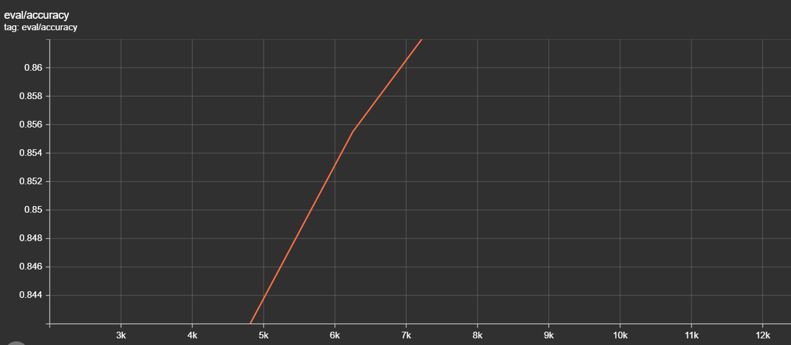
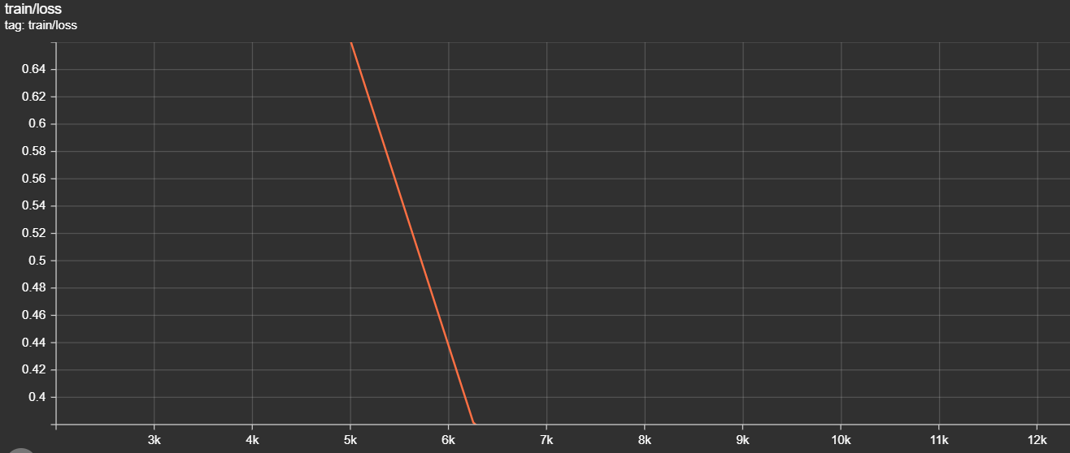
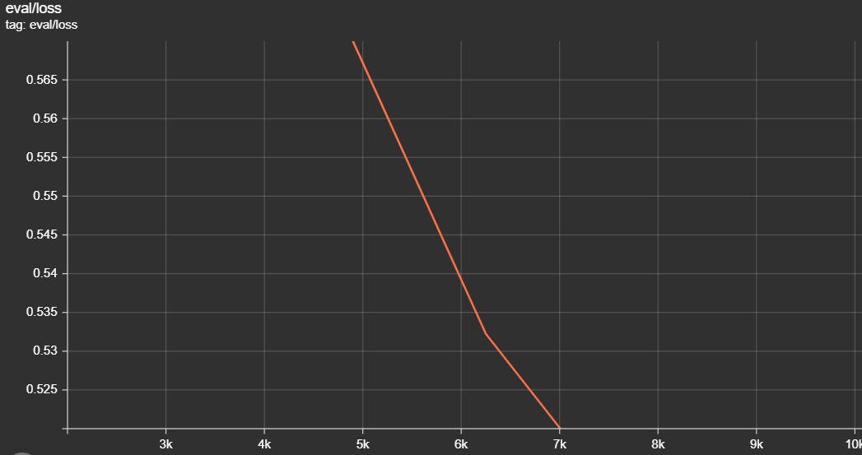
Results and Visualizations
Evaluation for Cifar-100: 4 epochs, Batch size= 8
Model achieved accuracy of 0.8985, Loss of 0.442

Slide 7
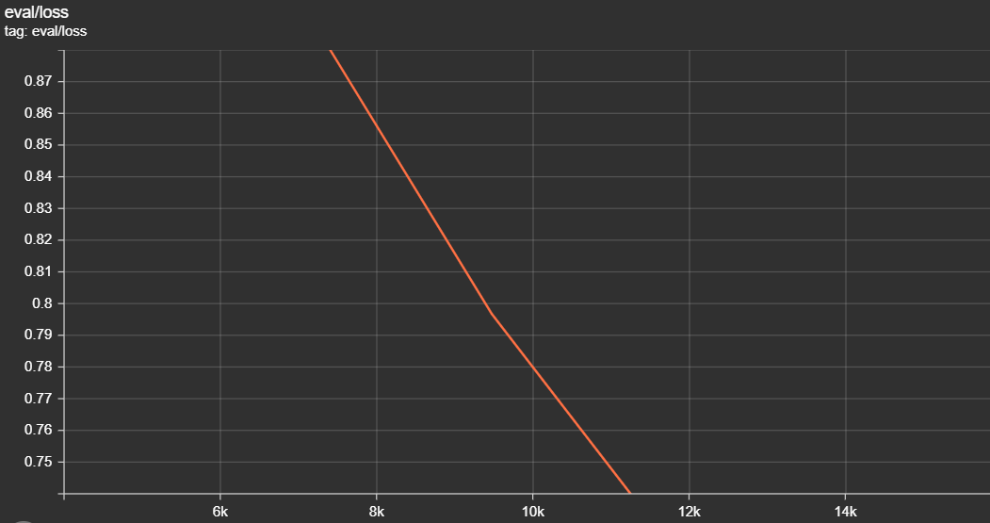
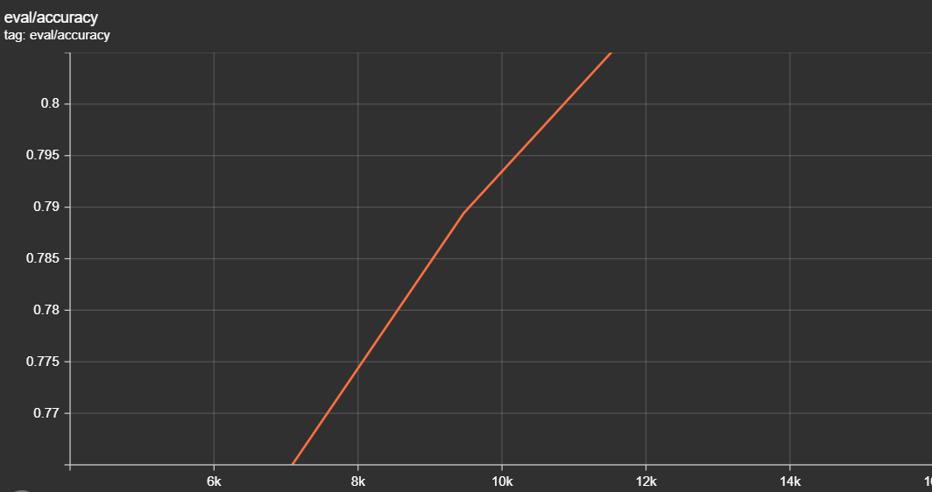
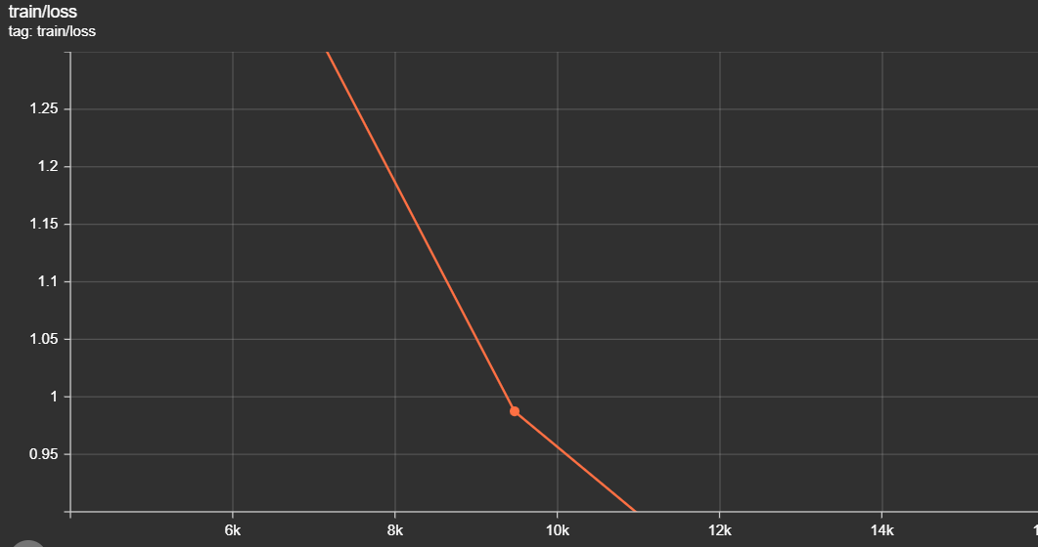
Results and Visualizations
Evaluation for Food-101: 4 epochs, Batch size= 8
Model achieved accuracy of 0.8558, Loss of 0.5434

